Slide 1
Convergence of a Markov chain to steady state
Daniel Chertok

Slide 2
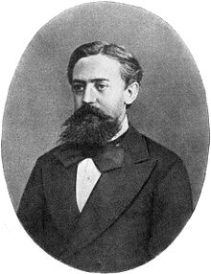

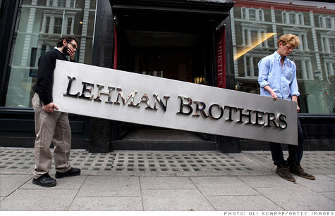

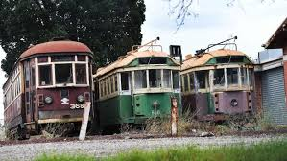
What kind of chain?..
Mar·kov chain /ˈmärˌkôf,-ˌkôv/
a stochastic model describing a sequence of possible events in which the probability of each event depends only on the state attained in the previous event.
Origin
mid 20th century: named after Andrei A. Markov (1856–1922), Russian mathematician.

Slide 3
The problem
Patient?
Business?
System?
A
A
B
B
C
C

Slide 4

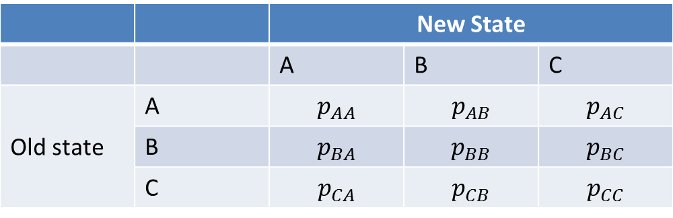
Transitional matrix of probabilities
 |  | New State
 |  | A | B | C
Old state | A | $$p_{AA}$$ | $$p_{AB}$$ | $$p_{AC}$$
 | B | $$p_{BA}$$ | $$p_{BB}$$ | $$p_{BC}$$
 | C | $$p_{CA}$$ | $$p_{CB}$$ | $$p_{CC}$$
${\text{P}}_{transition}$ = $P^{T}$ =$\left[\begin{aligned}p_{AA} p_{AB} p_{AC} \\ p_{BA} p_{BB} p_{BC} \\ p_{CA} p_{CB} p_{CC} \end{aligned}\right]$

Slide 5
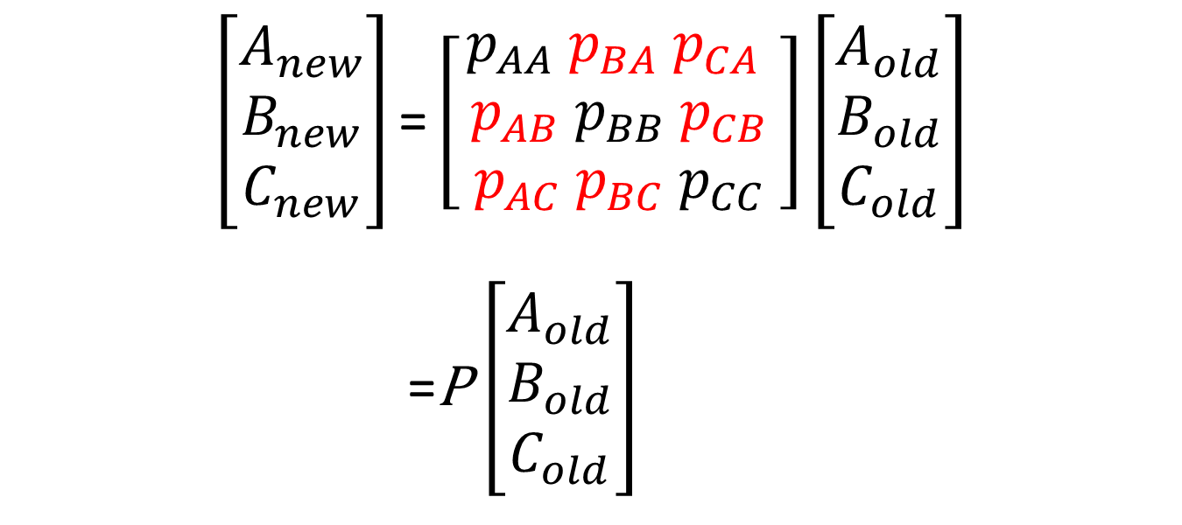
Transformation
$$\left[\begin{matrix}A_{new} \\ B_{new} \\ C_{new}\end{matrix}\right]\text{=}\left[\begin{aligned}p_{AA} p_{BA} p_{CA} \\ p_{AB} p_{BB} p_{CB} \\ p_{AC} p_{BC} p_{CC} \end{aligned}\right]\left[\begin{matrix}A_{old} \\ B_{old} \\ C_{old}\end{matrix}\right]$$
=P $\left[\begin{matrix}A_{old} \\ B_{old} \\ C_{old}\end{matrix}\right]$
The “true” transition matrix is${{(P}^{T}\text{)}}^{T}$= $P$

Slide 6
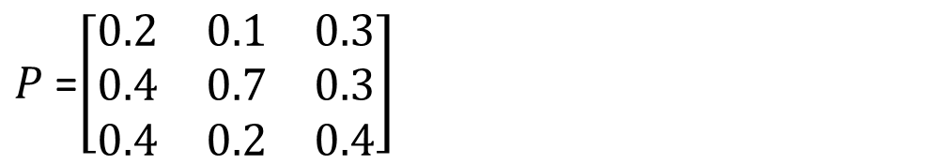
Example
 |  | New State
 |  | A | B | C
Old state | A | 0.2 | 0.4 | 0.4
 | B | 0.1 | 0.7 | 0.2
 | C | 0.3 | 0.3 | 0.4
$P$ =$\left[\begin{matrix}0.2 & 0.1 & 0.3 \\ 0.4 & 0.7 & 0.3 \\ 0.4 & 0.2 & 0.4\end{matrix}\right]$

Slide 7
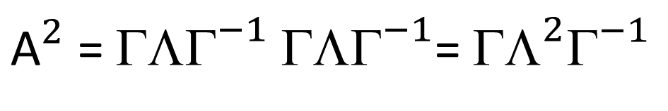
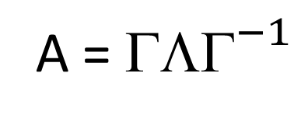
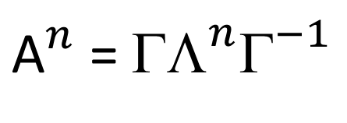
Powers of a diagonalizable matrix
A = ${\text{ΛΓ}}^{−1}$
${\text{A}}^{2}$ = ${\text{ΛΓ}}^{−1}$ ${\text{ΛΓ}}^{−1}$= ${\text{Λ}}^{2}{\text{Γ}}^{−1}$
${\text{A}}^{n}$ = ${\text{Λ}}^{n}{\text{Γ}}^{−1}$

Slide 8
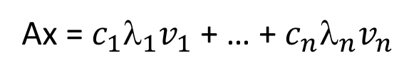
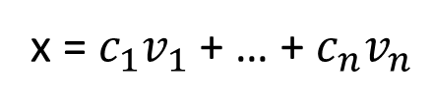
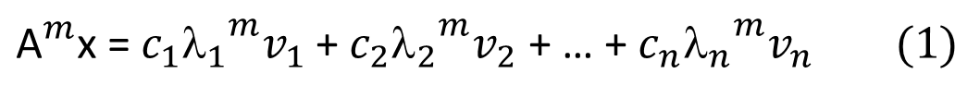
Eigenvalues and eigenvectors
Av = λv
x = $c_{1}v_{1}$ + … + $c_{n}v_{n}$
Ax = $c_{1}{{\text{λ}}_{1}v}_{1}$ + … + $c_{n}{\text{λ}}_{n}v_{n}$
${\text{A}}^{m}$x = $c_{1}{{{\text{λ}}_{1}}_{}^{m}v}_{1}$ + $c_{2}{{{\text{λ}}_{2}}_{}^{m}v}_{2}$ + … + $c_{n}{{{\text{λ}}_{n}^{}}_{}^{m}v}_{n} (1)$
$\lim_{m→∞}{{\text{A}}^{m}\text{x}}$ = $c_{1}\lim_{m→∞}{{{\text{λ}}_{1}}_{}^{m}v}_{1 }$ $(2)$

Slide 9
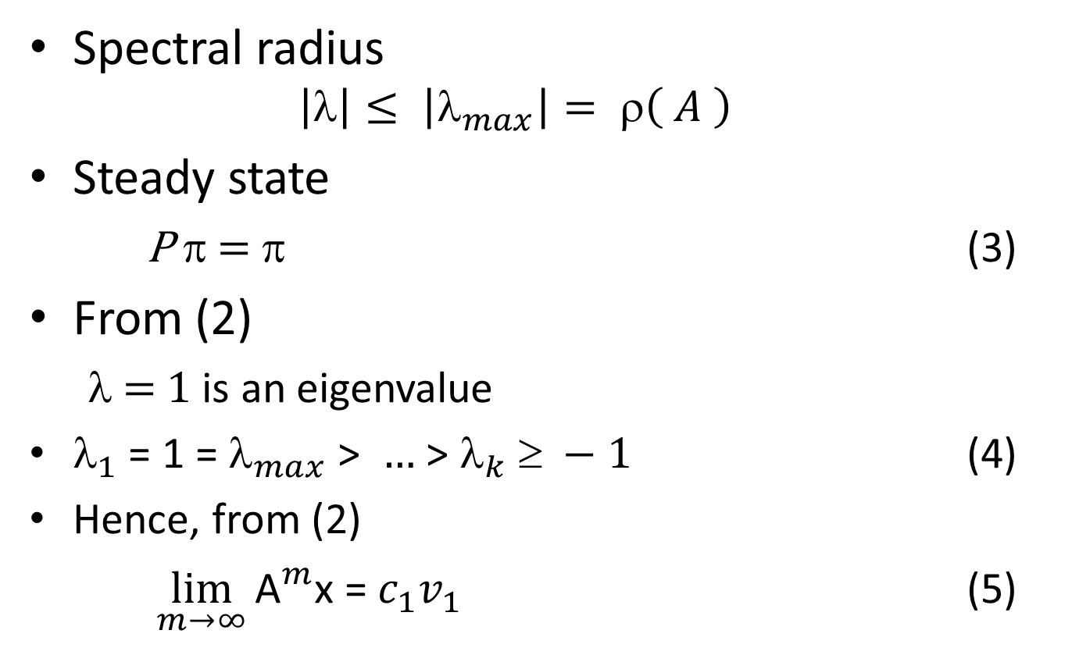
Perron-Frobenius Theorem
Spectral radius
$$\left|\right|≤ \left|λ_{max}\right|= ρ\left( A \right)$$
Steady state
P π = π (3)
From (2)
$$ = 1 is an eigenvalue
$_{1}$ = 1 = $_{max}$ > $…$ > $_{k}  −1$ (4)
Hence, from (2)
$\lim_{m→∞}{{\text{A}}^{m}\text{x}}$ = $c_{1}v_{1 }$ (5)

Slide 10
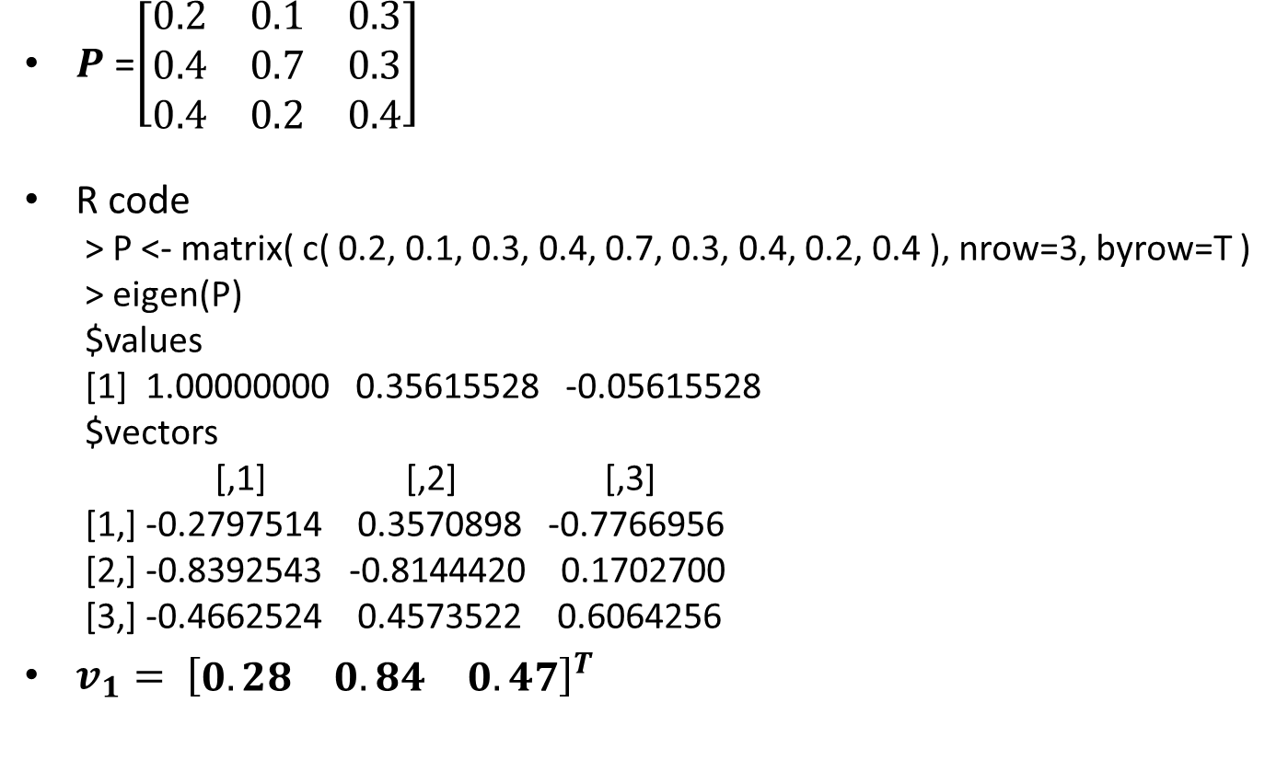
Back to our example
$P$ =$\left[\begin{matrix}0.2 & 0.1 & 0.3 \\ 0.4 & 0.7 & 0.3 \\ 0.4 & 0.2 & 0.4\end{matrix}\right]$
R code
> P <- matrix( c( 0.2, 0.1, 0.3, 0.4, 0.7, 0.3, 0.4, 0.2, 0.4 ), nrow=3, byrow=T )
> eigen(P)
$values
[1] 1.00000000 0.35615528 -0.05615528
$vectors
[,1] [,2] [,3]
[1,] -0.2797514 0.3570898 -0.7766956
[2,] -0.8392543 -0.8144420 0.1702700
[3,] -0.4662524 0.4573522 0.6064256
$v_{1}= {\left[\begin{matrix}0.28 & 0.84 & 0.47\end{matrix}\right]}^{T}$
eigen( P ) – eigenvalues and eigenvectors of P : Px = λx

Slide 11

How soon will it converge?
From (1), (3) and (5) and the triangle inequality :
$$\left\|{ P}^{m}x−\text{π}\right\| ≤ c_{2}{λ_{2}}^{m}\left\|v_{2}\right\|\text{ + … +}c_{n}{λ_{n}}^{m}\left\|v_{n}\right\|$$
since${ }_{1}=1$
We can choose $\left\|v_{i}\right\|=1 , so$
$$\left\|{ P}^{m}x−\text{π}\right\| ≤ c_{2}{λ_{2}}^{m}\text{+ … +}c_{n}{λ_{n}}^{m}$$
If 1 >> ${| }_{2} |≫ …≫{| }_{k} |, then convergence is very quick$

Slide 12
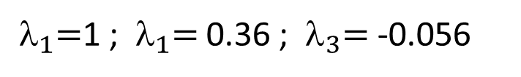
Example : convergence
>library( expm )
>P %^% 4
[,1] [,2] [,3]
[1,] 0.1792 0.1731 0.1809
[2,] 0.5232 0.5371 0.5193
[3,] 0.2976 0.2898 0.2998
>P %^% 8
[,1] [,2] [,3]
[1,] 0.1765144 0.1764163 0.1765419
[2,] 0.5293118 0.5295355 0.5292490
[3,] 0.2941738 0.2940482 0.2942090
> P %^% 100
[,1] [,2] [,3]
[1,] 0.1764706 0.1764706 0.1764706
[2,] 0.5294118 0.5294118 0.5294118
[3,] 0.2941176 0.2941176 0.2941176
${ }_{1}=$1 ; ${ }_{1}=$0.36 ; ${ }_{3}=$ -0.056

Slide 13
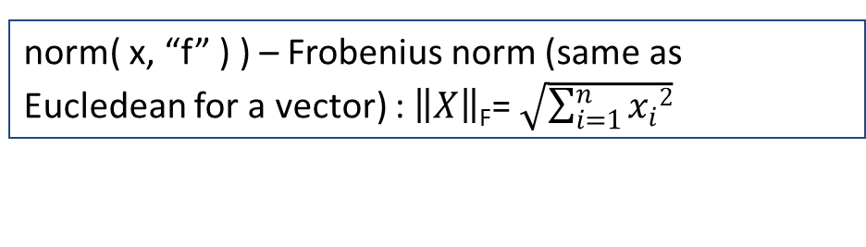
Wait a minute…
> ( P %^% 100 )[, 1]
[1] 0.1764706 0.5294118 0.2941176
But
> -eigen( P )$vectors[, 1]
[1] 0.2797514 0.8392543 0.4662524
How so?
norm( x, “f” ) ) – Frobenius norm (same as Eucledean for a vector) : $\left\|X\right\|$_{F}= $\sqrt{\sum_{i=1}^{n}{x_{i}2}}$
Observe that
> ( P %^% 100 )[, 1] / norm( as.matrix( ( P %^% 100 )[, 1] ), "f" )
[1] 0.2797514 0.8392543 0.4662524
Phew...

Slide 14
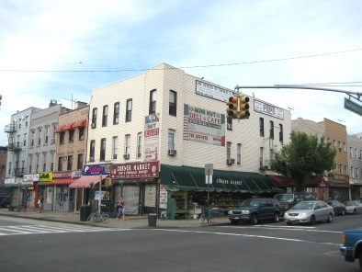
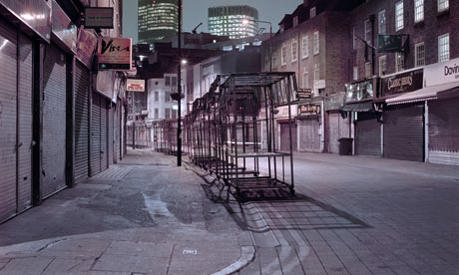
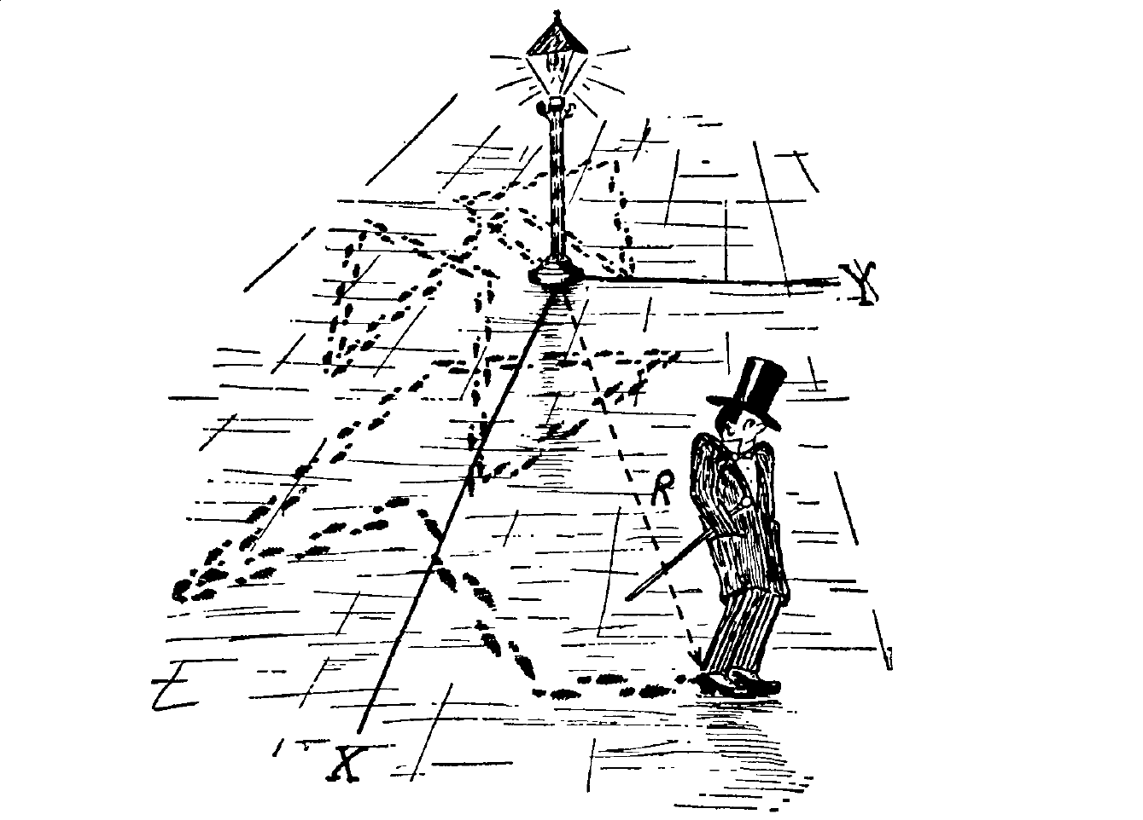
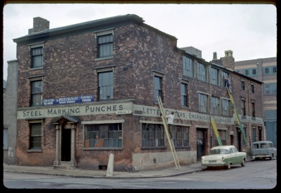


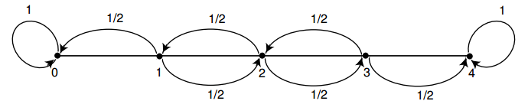
What if?...
2
3
1
4
0

Slide 15

Transition matrix for an absorbing chain
$P$ =$\begin{matrix}\begin{matrix}0 & 1 & 2 & 3 & 4\end{matrix} \\ \left[\begin{matrix}1 & \frac{1}{2} & 0 & 0 & 0 \\ 0 & 0 & \frac{1}{2} & 0 & 0 \\ 0 & \frac{1}{2} & 0 & \frac{1}{2} & 0 \\ 0 & 0 & \frac{1}{2} & 0 & \frac{1}{2} \\ 0 & 0 & 0 & 0 & 1\end{matrix}\right]\end{matrix}$
0
1
2
3
4

Slide 16
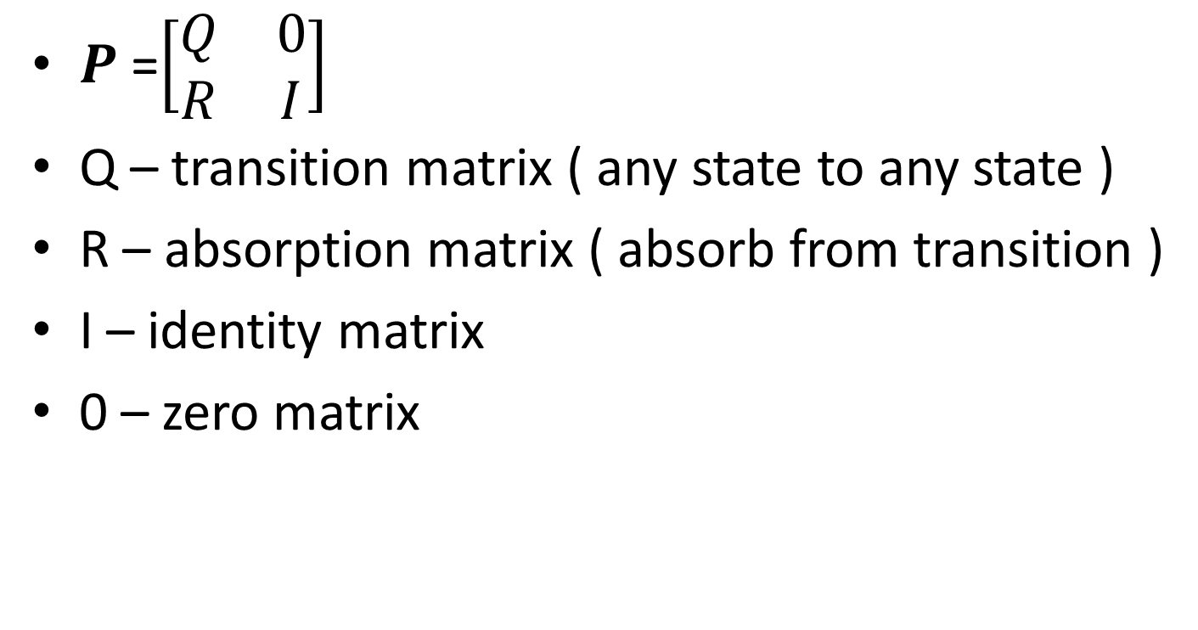
Canonical form of the transition matrix
$P$ =$\left[\begin{matrix}Q & 0 \\ R & I\end{matrix}\right]$
Q – transition matrix ( any state to any state )
R – absorption matrix ( absorb from transition )
I – identity matrix
0 – zero matrix

Slide 17
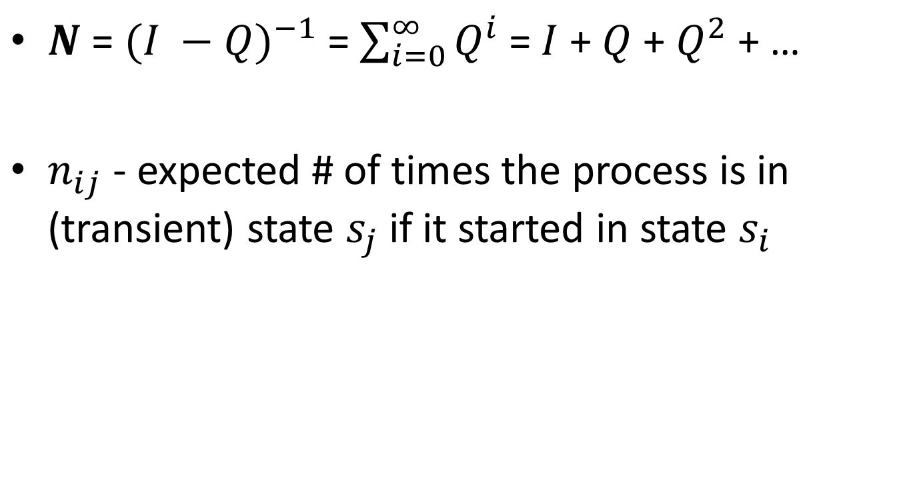
Fundamental matrix
$N$ = ${(I −Q)}^{−1}$ = $\sum_{i=0}^{∞}{Q^{i}}$ =$I$ + $Q$ + $Q^{2}$ + …
$n_{ij}$ - expected # of times the process is in (transient) state $s_{j}$if it started in state $s_{i}$

Slide 18

Rearranging our drunkard’s walk
Q
0
$P$ =$\begin{matrix}\begin{matrix}1 & 2 & 3 & 0 & 4\end{matrix} \\ \left[\begin{matrix}0 & \frac{1}{2} & 0 & 0 & 0 \\ \frac{1}{2} & 0 & \frac{1}{2} & 0 & 0 \\ 0 & \frac{1}{2} & 0 & 0 & 0 \\ \frac{1}{2} & 0 & 0 & 1 & 0 \\ 0 & 0 & \frac{1}{2} & 0 & 1\end{matrix}\right]\end{matrix}$
1
> P <- matrix( c( 0, 0.5, 0, 0, 0, 0.5, 0, 0.5, 0, 0, 0, 0.5, 0, 0, 0, 0.5, 0, 0, 1, 0, 0, 0, 0.5, 0, 1 ), nrow=5, byrow=T )
> Q <- P[1:3, 1:3]
> R <- P[4:5, 1:3]
2
3
0
4
R
I

Slide 19
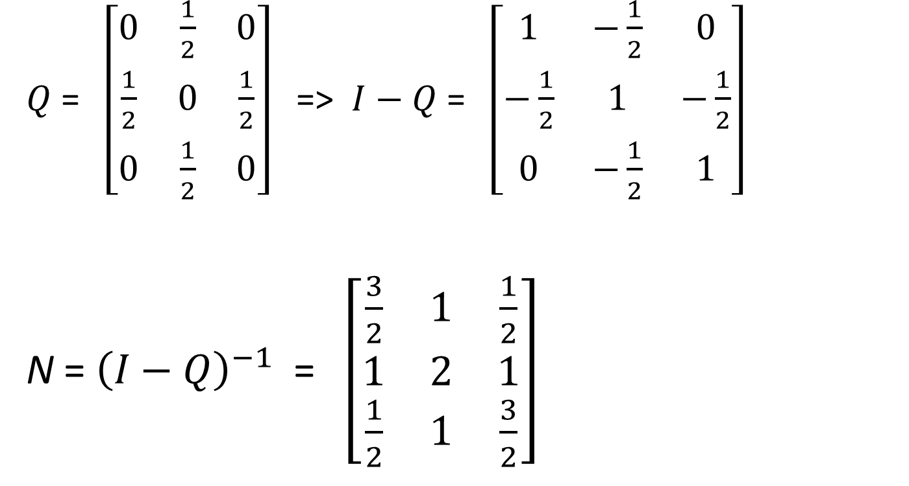
Fundamental matrix
$Q$ =$\begin{matrix}\left[\begin{matrix}0 & \frac{1}{2} & 0 \\ \frac{1}{2} & 0 & \frac{1}{2} \\ 0 & \frac{1}{2} & 0\end{matrix}\right]\end{matrix}$ => $I−Q$ =$\begin{matrix}\left[\begin{matrix}1 & −\frac{1}{2} & 0 \\ −\frac{1}{2} & 1 & −\frac{1}{2} \\ 0 & −\frac{1}{2} & 1\end{matrix}\right]\end{matrix}$
N = ${\left(I−Q\right)}^{−1}$ =$\begin{matrix}\left[\begin{matrix}\frac{3}{2} & 1 & \frac{1}{2} \\ 1 & 2 & 1 \\ \frac{1}{2} & 1 & \frac{3}{2}\end{matrix}\right]\end{matrix}$
> library( pracma )
> N <- inv( eye( nrow( Q ) ) - Q )

Slide 20
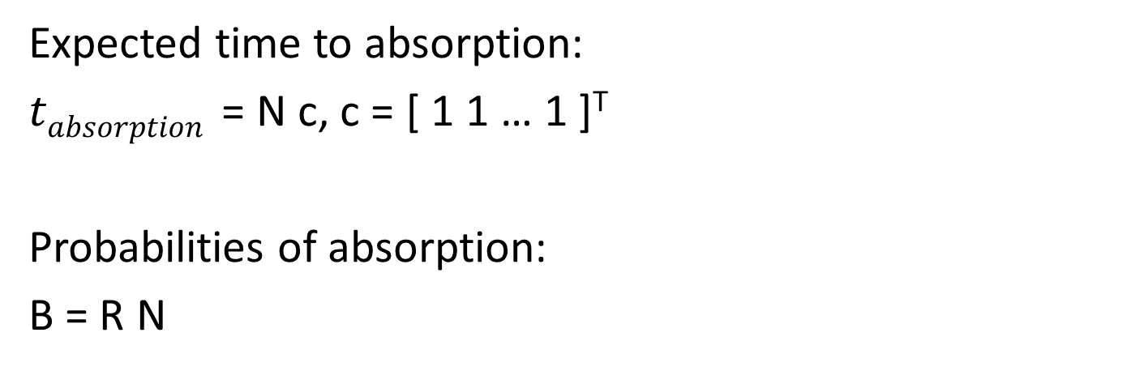
Prediction theory
Expected time to absorption:
$tabsorption$ = N c, c = [ 1 1 … 1 ]^{T}
Probabilities of absorption:
B = R N

Slide 21
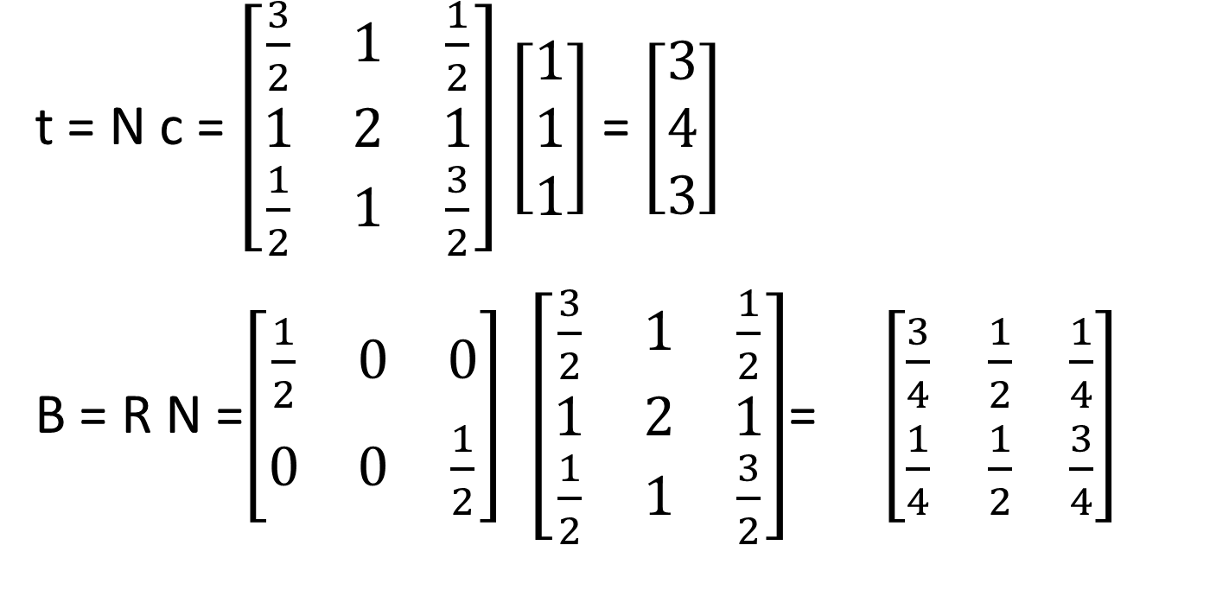
Predictions
t = N c = $\begin{matrix}\left[\begin{matrix}\frac{3}{2} & 1 & \frac{1}{2} \\ 1 & 2 & 1 \\ \frac{1}{2} & 1 & \frac{3}{2}\end{matrix}\right]\end{matrix}$ $\left[\begin{matrix}1 \\ 1 \\ 1\end{matrix}\right]$ = $\left[\begin{matrix}3 \\ 4 \\ 3\end{matrix}\right]$
B = R N =$\begin{matrix}\left[\begin{matrix}\frac{1}{2} & 0 & 0 \\ 0 & 0 & \frac{1}{2}\end{matrix}\right]\end{matrix}$ $\begin{matrix}\left[\begin{matrix}\frac{3}{2} & 1 & \frac{1}{2} \\ 1 & 2 & 1 \\ \frac{1}{2} & 1 & \frac{3}{2}\end{matrix}\right]\end{matrix}$= $\left[\begin{matrix}\frac{3}{4} & \frac{1}{2} & \frac{1}{4} \\ \frac{1}{4} & \frac{1}{2} & \frac{3}{4}\end{matrix}\right]$
1
2
3
0
4
> c <- rep( 1, ncol( N ) )
> t <- N %*% c
> B <- R %*% N

Slide 22


Slide 23


Slide 24
Credit migration
Q
0
Old
AAA AA A BBB BB B C DF PO
CM <- c( 0.77, 0.05, 0.02, 0.02, 0.005, 0.002, 0.001, 0, 0,
0.05, 0.72, 0.05, 0.03, 0.01, 0.005, 0.003, 0, 0,
0.01, 0.07, 0.68, 0.06, 0.005, 0.01, 0.005, 0, 0,
0.007, 0.01, 0.07, 0.67, 0.07, 0.05, 0.03, 0, 0,
0.006, 0.008, 0.04, 0.05, 0.65, 0.08, 0.13, 0, 0,
0.003, 0.004, 0.03, 0.02, 0.08, 0.55, 0.18, 0, 0,
0.002, 0.004, 0.01, 0.01, 0.03, 0.1, 0.4, 0, 0,
0.002, 0.004, 0.02, 0.12, 0.14, 0.2, 0.25, 1, 0,
0.15, 0.13, 0.08, 0.02, 0.01, 0.003, 0.001, 0, 1 )
AA
A
BBB
New
BB
B
C
DF
PO
R
I
CMM <- matrix( CM, nrow=9, ncol=9, byrow=TRUE )

Slide 25
Credit migration questions
Q.: How soon is everyone in the population expected to default or pay off?
A.:
Q = V Λ V⁻¹ => ||Q^{m}|| ≤ (λ_{max})^{m} since ||V|| = 1
If || Q^{m} || < 10⁻⁴ , then m < -4 / log(λ_{max} )
> Q <- CMM[1:7, 1:7]
> eigen(Q)$values
[1] 0.8531 0.7727 0.7052 0.6486 0.6047 0.5335 0.3222
> -4 / log10( max( eigen( Q )$values ) )
[1] 57.95559

Slide 26
Credit migration continued…
> Q %^% 58 [,1] [,2] [,3] [,4] [,5] [,6] [,7] [1,] 2.121376e-05 2.405401e-05 2.433682e-05 2.064453e-05 1.612878e-05 1.278918e-05 1.153732e-05 [2,] 1.959759e-05 2.229833e-05 2.261457e-05 1.918772e-05 1.501710e-05 1.191065e-05 1.074663e-05 [3,] 1.623674e-05 1.852918e-05 1.883163e-05 1.598117e-05 1.252705e-05 9.937858e-06 8.967997e-06 [4,] 1.721449e-05 1.971760e-05 2.009387e-05 1.705682e-05 1.339727e-05 1.063117e-05 9.595526e-06 [5,] 1.527149e-05 1.750415e-05 1.784745e-05 1.515071e-05 1.190475e-05 9.447310e-06 8.527316e-06 [6,] 9.691351e-06 1.110862e-05 1.132678e-05 9.615340e-06 7.555451e-06 5.995833e-06 5.411959e-06 [7,] 4.150580e-06 4.756786e-06 4.849643e-06 4.116831e-06 3.234609e-06 2.566881e-06 2.316899e-06
In reality, m = 50:
> Q %^% 50
[,1] [,2] [,3] [,4] [,5] [,6] [,7]
[1,] 7.635670e-05 8.596411e-05 8.653814e-05 7.337510e-05 5.711078e-05 4.526157e-05 4.081627e-05
[2,] 7.015310e-05 7.959611e-05 8.054667e-05 6.832580e-05 5.338480e-05 4.233183e-05 3.818852e-05
[3,] 5.784699e-05 6.606548e-05 6.716592e-05 5.699976e-05 4.468850e-05 3.545308e-05 3.199370e-05
[4,] 6.096631e-05 7.018607e-05 7.178777e-05 6.095886e-05 4.800951e-05 3.811130e-05 3.440763e-05
[5,] 5.402461e-05 6.228583e-05 6.378151e-05 5.416692e-05 4.269831e-05 3.389915e-05 3.060745e-05
[6,] 3.428214e-05 3.952775e-05 4.047928e-05 3.437751e-05 2.710002e-05 2.151544e-05 1.942632e-05
[7,] 1.468614e-05 1.692715e-05 1.733019e-05 1.471752e-05 1.159976e-05 9.209124e-06 8.314778e-06

Slide 27
Caveat emptor!
> eq$vectors %*% diag( eq$values ) %^% 50 %*% inv( eq$vectors ) [,1] [,2] [,3] [,4] [,5] [,6] [,7] [1,] -5.189521e-05 -5.467050e-05 -2.008326e-05 5.477612e-06 1.051442e-05 3.402738e-06 1.805085e-06 [2,] -5.778528e-05 -6.094839e-05 -2.250186e-05 6.081816e-06 1.179032e-05 3.813656e-06 2.028353e-06 [3,] -3.062288e-05 -3.221031e-05 -1.196797e-05 3.083289e-06 6.229764e-06 2.022915e-06 1.063104e-06 [4,] 1.571387e-05 1.670790e-05 6.255584e-06 -1.711868e-06 -3.311850e-06 -1.064549e-06 -5.794353e-07 [5,] 1.151319e-05 1.214451e-05 4.574282e-06 -1.144276e-06 -2.384674e-06 -7.735768e-07 -4.088434e-07 [6,] 3.062978e-06 3.213673e-06 1.207795e-06 -2.905503e-07 -6.240609e-07 -2.035304e-07 -1.055987e-07 [7,] 1.792105e-06 1.886679e-06 7.140558e-07 -1.721212e-07 -3.705155e-07 -1.205270e-07 -6.315983e-08
> Q %^% 50 [,1] [,2] [,3] [,4] [,5] [,6] [,7] [1,] 7.635670e-05 8.596411e-05 8.653814e-05 7.337510e-05 5.711078e-05 4.526157e-05 4.081627e-05 [2,] 7.015310e-05 7.959611e-05 8.054667e-05 6.832580e-05 5.338480e-05 4.233183e-05 3.818852e-05 [3,] 5.784699e-05 6.606548e-05 6.716592e-05 5.699976e-05 4.468850e-05 3.545308e-05 3.199370e-05 [4,] 6.096631e-05 7.018607e-05 7.178777e-05 6.095886e-05 4.800951e-05 3.811130e-05 3.440763e-05 [5,] 5.402461e-05 6.228583e-05 6.378151e-05 5.416692e-05 4.269831e-05 3.389915e-05 3.060745e-05 [6,] 3.428214e-05 3.952775e-05 4.047928e-05 3.437751e-05 2.710002e-05 2.151544e-05 1.942632e-05 [7,] 1.468614e-05 1.692715e-05 1.733019e-05 1.471752e-05 1.159976e-05 9.209124e-06 8.314778e-06 HUH?!!!
> eq$vectors %*% ( diag( eq$values ) %^% 50 ) %*% inv( eq$vectors ) [,1] [,2] [,3] [,4] [,5] [,6] [,7] [1,] 7.635670e-05 8.596411e-05 8.653814e-05 7.337510e-05 5.711078e-05 4.526157e-05 4.081627e-05 [2,] 7.015310e-05 7.959611e-05 8.054667e-05 6.832580e-05 5.338480e-05 4.233183e-05 3.818852e-05 [3,] 5.784699e-05 6.606548e-05 6.716592e-05 5.699976e-05 4.468850e-05 3.545308e-05 3.199370e-05 [4,] 6.096631e-05 7.018607e-05 7.178777e-05 6.095886e-05 4.800951e-05 3.811130e-05 3.440763e-05 [5,] 5.402461e-05 6.228583e-05 6.378151e-05 5.416692e-05 4.269831e-05 3.389915e-05 3.060745e-05 [6,] 3.428214e-05 3.952775e-05 4.047928e-05 3.437751e-05 2.710002e-05 2.151544e-05 1.942632e-05 [7,] 1.468614e-05 1.692715e-05 1.733019e-05 1.471752e-05 1.159976e-05 9.209124e-06 8.314778e-06
Now, how do I convince my CIO to use OpenSource software?..

Slide 28
Back to credit migrartion…
Q.: How soon can I expect an A-rated credit to end up in default?
A.:
> inv( eye( nrow( Q ) ) - Q ) %*% rep( 1, ncol( N ) )
[,1]
[1,] 7.419693
[2,] 7.327131
[3,] 6.741424
[4,] 7.627498
[5,] 7.573138
[6,] 5.801716
[7,] 3.325338

Slide 29
Last of credit migrartion…
Q.: What are the probabilities of final payoff and default?
A.:
> CMM [,1] [,2] [,3] [,4] [,5] [,6] [,7] [,8] [,9] [1,] 0.770 0.050 0.02 0.02 0.005 0.002 0.001 0 0 [2,] 0.050 0.720 0.05 0.03 0.010 0.005 0.003 0 0 [3,] 0.010 0.070 0.68 0.06 0.005 0.010 0.005 0 0 [4,] 0.007 0.010 0.07 0.67 0.070 0.050 0.030 0 0 [5,] 0.006 0.008 0.04 0.05 0.650 0.080 0.130 0 0 [6,] 0.003 0.004 0.03 0.02 0.080 0.550 0.180 0 0 [7,] 0.002 0.004 0.01 0.01 0.030 0.100 0.400 0 0 [8,] 0.002 0.004 0.02 0.12 0.140 0.200 0.250 1 0 [9,] 0.150 0.130 0.08 0.02 0.010 0.003 0.001 0 1 > CMM[8:9, 1:7] %*% inv( eye( nrow( Q ) ) - Q ) > [,1] [,2] [,3] [,4] [,5] [,6] [,7] > [1,] 0.1414434 0.2313675 0.4723605 0.6859007 0.8315032 0.8824371 0.90118079 > [2,] 0.8585566 0.7686325 0.5276395 0.3140993 0.1684968 0.1175629 0.09881921
R
D
PO

Slide 30
References
http://www.ece.rice.edu/~vc3/elec633/MarkovChains.pdf
https://www.math.ucdavis.edu/~gravner/MAT135B/materials/ch15.pdf
http://physiology.med.cornell.edu/people/banfelder/qbio/resources_2012/2012_4.3%20Markov%20Chains%20and%20Hidden%20Markov%20Models.pdf
Wait, there’s no sales pitch ?!...
Of course there is! Here you are…
http://northshoreanalytics.org
https://github.com/northshoreanalytics

Slide 31


Sweet dreams!

